Slide 1






Improving Patient Access to Malaria Drugs in Zambia
Results of a Pilot Project

Slide 2
Partnership
DFID
USAID
The World
Bank
MOH
John Snow
Inc.
Crown Agents

Slide 3
Introduction

Slide 4
Why was the pilot designed?
  Zambia has been successful in expanding access to preventive services for malaria but treatment is lagging behind prevention efforts

Slide 5
Problem: Drugs are often times unavailable in health facilities
The baseline survey conducted in Dec/Jan 08/09 shows that drugs were not available at the time of the visit:
  Pediatric ACT was unavailable in 40% of the facilities
  SP was unavailable in 55% of the facilities
  Amoxicillin was not available in 72% of the facilities
  Stock-outs on district level are less common indicating that distribution from districts to health facilities is the main bottleneck in the system

Slide 6
Unavailability of lifesaving drugs before the pilot
Dec 2008-Jan 2009

Slide 7
Improving access to essential drugs in Zambia
Objective
Identify the most cost-effective way to improve the availability of drugs through strengthening of the supply chain from district to health facility
Approach
Pilot project that compares the effectiveness of two different supply chain interventions to select one (or a combination/variation) that can be rolled-out nationally

Slide 8
Design

Slide 9
Improving the overall supply chain
The project was initially focused on malaria drugs only
To avoid a fragmented supply chain and increase the impact of the pilot on health outcomes the focus shifted from malaria drugs only to all essential drugs

Slide 10
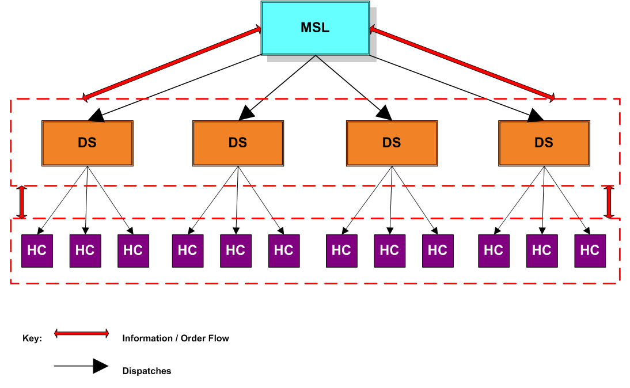
Distribution Structure before the pilot
72 district stores
Approx.1450 health centers

Slide 11
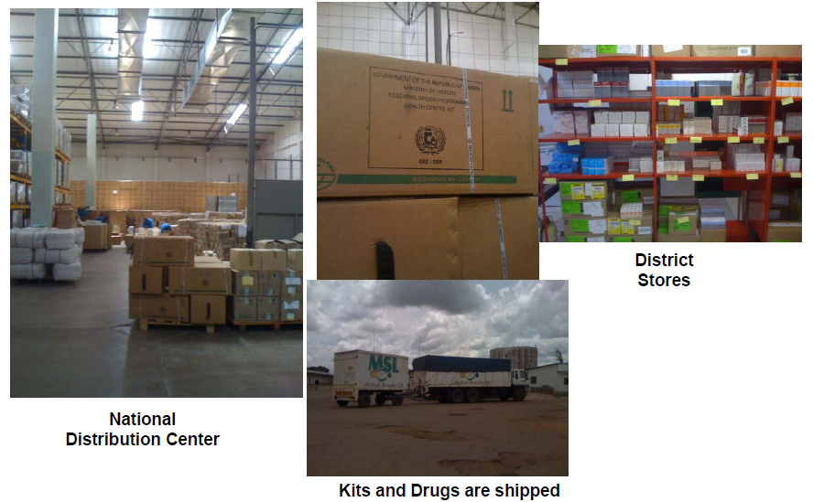

Slide 12
2 Interventions Tested
Common design features for A & B systems:
Commodity Planner (CP) dedicated to logistics based in District Health Office (DHO)
System A:
Health Facilities (HFs) place orders to DHO who places orders to MSL
Kits are disaggregated into individual drugs at the central level and distributed to the district store
Districts are responsible for assembling orders for the health facilities and transportation from district to health facility
System B:
HFs place orders directly to MSL
Kits are disaggregated at the central level and packed in sealed packages to each individual facility
Districts only responsible for transportation from district to health facility

Slide 13
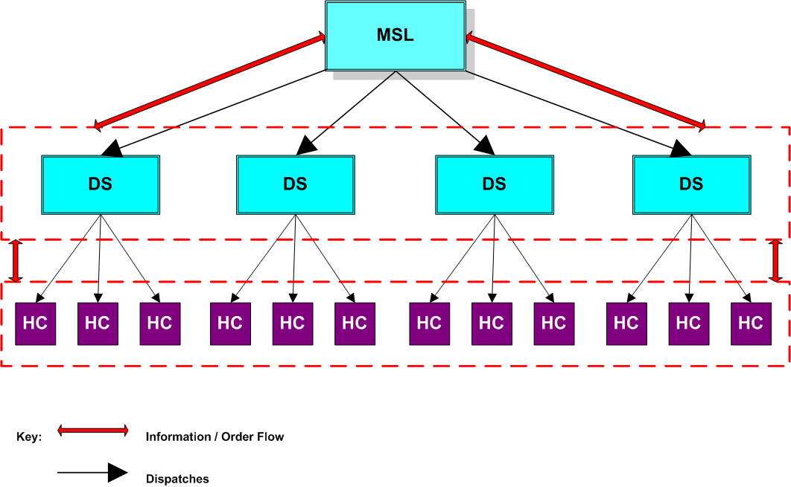


System A
Commodity Planners
Commodity planner
Commodity planner
Commodity planner
Commodity planner

Slide 14
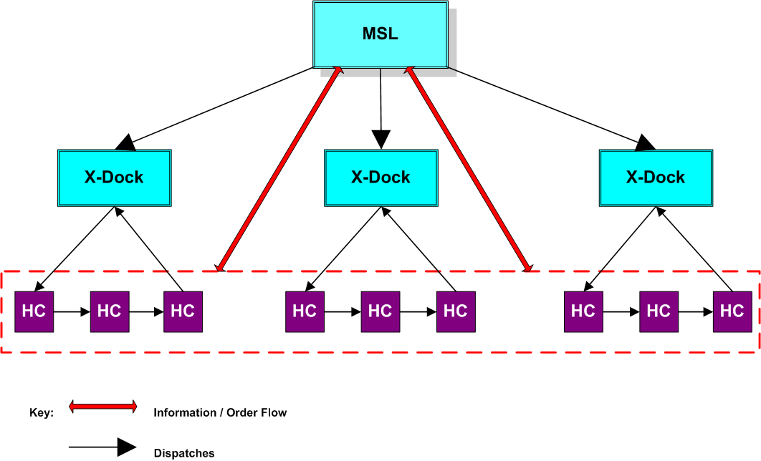

System B
Commodity Planner + Sealed Packages
Commodity planner
Commodity planner
Commodity planner

Slide 15
Pilot Evaluation Design
Districts randomly selected from 54 peri-urban and rural districts in Zambia
Total of 24 districts: 8 districts for system A, 8 districts for system B and 8 control districts
Pilot implementation for a one-year period
Baseline data collected in Dec-Jan 2008 and follow-up data during the same period in 2009

Slide 16
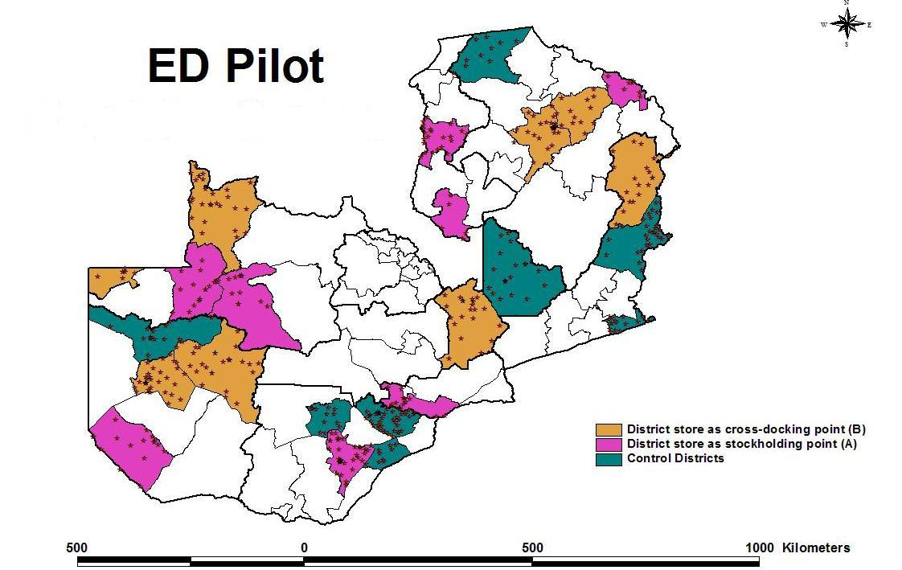
District Selection

Slide 17
Results

Slide 18
Reduced Stockouts in A System
*the reduction in stockout rate is statistically significant with respect to any observed change in control districts

Slide 19
Dramatically Reduced Stockouts in
B System
*the reduction in stockout rate is statistically significant with respect to any observed change in control districts

Slide 20
Average decrease in stockout probability from control to option B for pediatric ACT is 38 percentage points

Slide 21
Days of Stockouts for Malaria Drugs reduced (Q4 2009=90 days)

Slide 22

Far more people get their lifesaving drugs in B districts
Share of population demand for lifesaving drugs not met due to unavailability in Q4

Slide 23
Average Reporting Rates to MSL

Slide 24
Improved Storage Conditions in intervention districts

Slide 25
Impact on under five deaths
Preliminary estimations show that currently there are 200,000 children U5 per year with malaria who visit a public health facility and cannot be treated because the drugs are not available
With a nationwide scale up of model A this number would be reduced to 100,000
With a nationwide scale up of model B it would be reduced to 40,000

Slide 26
Impact on under five deaths
Preliminary calculations suggest that as a result of the increase in access to one drug(pediatric ACT) out of all essential drugs
  About 5600 under five deaths/year (18% of malaria deaths) could be averted if the B system was to be scaled up nationwide
  The benefits are much higher if stock improvements of all drugs are taken into account

Slide 27
Costs of Improving the Supply Chain
Cost-effectiveness analysis is currently being conducted
A and B districts share the same cost structure for CPs
Operational Running Costs for CPs/ district (gross) | ZMK | USD
Set-up costs (training of CPs, laptop etc) | 13,250,000 | 2,650
Total monthly running costs (CP salary) | 6,900,000 | 1,380
Total yearly running costs | 82,800,000 | 16,560
Additional Costs to B at the central level: 13 pickers and packers, 2 data clerks taking orders from HF, 22 additional trips/month(because sealed packages take more space), packing material and stationary for sealed boxes

Slide 28
Summary of Results
System B performs significantly better than system A and control districts
There is a significant and large decrease in number of days of stockouts in B districts compared to control
Unmet demand is significantly lower in B districts compared to A and control
Reporting rates from district health officers to MSL have increased during the pilot period for both A and B districts to nearly 100%
Both A and B districts have significantly better storage conditions than control districts after the pilot period
Preliminary estimations for one drug show that the scale up of system B has the potential to avert a large number of under-five deaths

Slide 29
Next Steps
  Press Release of Results: April 20
  Cost-effectiveness analysis
  Technical Discussions on scenarios for scale-up April 19-23

Slide 30
For more information, contact:
Monique Vledder
Senior Health Specialist
202-478-2518 mvledder@worldbank.org

